Slide 1




RMA Projects Presents
MyQoran
Migration

Slide 2
Introduction
MyQoran is a Qoran app that made by RMA Projects to help users read and recite Qoran correctly, insya Alloh.

Slide 3
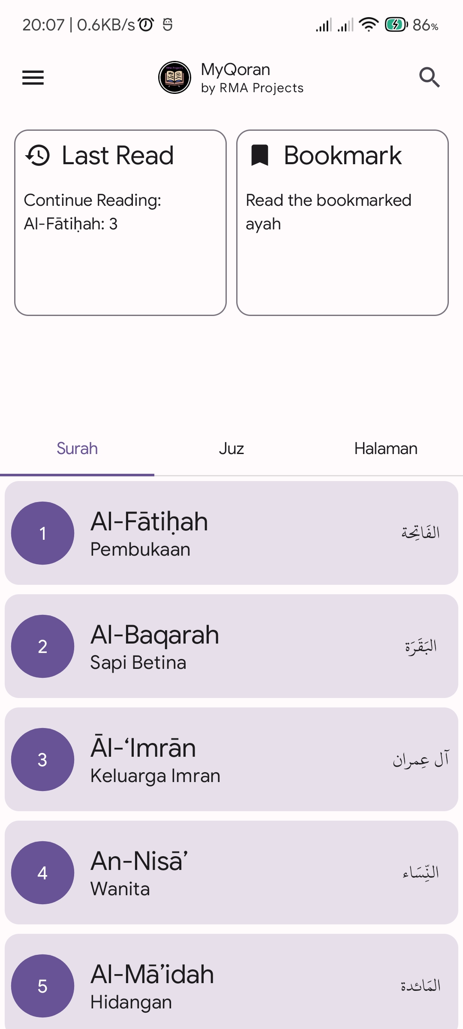
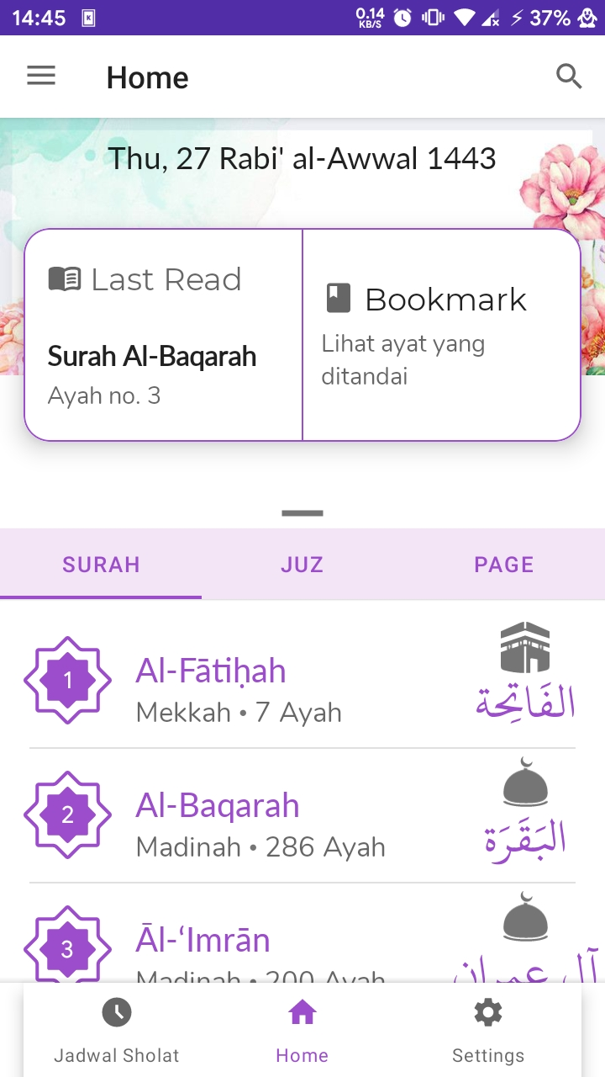
Home Screen

Slide 4
What have changed:
Redesign
Proper Material 3 usage
Removed unnecessary components
Removed Bottomsheet, added vertical weight instead
UI Replacement

Slide 5
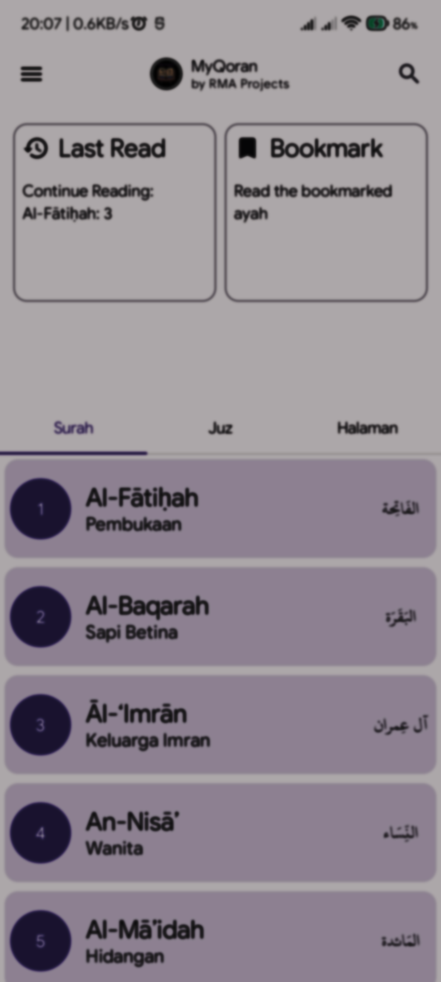
CenterAlignedTopBar
NavButton
Actions
IconButton
IconButton
Components

Slide 6
CenterAlignedTopBar
Row
Text
Image
Column
Text
Components

Slide 7
Since ViewPager isn’t available for Compose yet, we can use Pager by Google’s Accompanist
TabRow
Column
Index by Surah
HorizontalPager
Index by Juz
Index by Page
Components

Slide 8
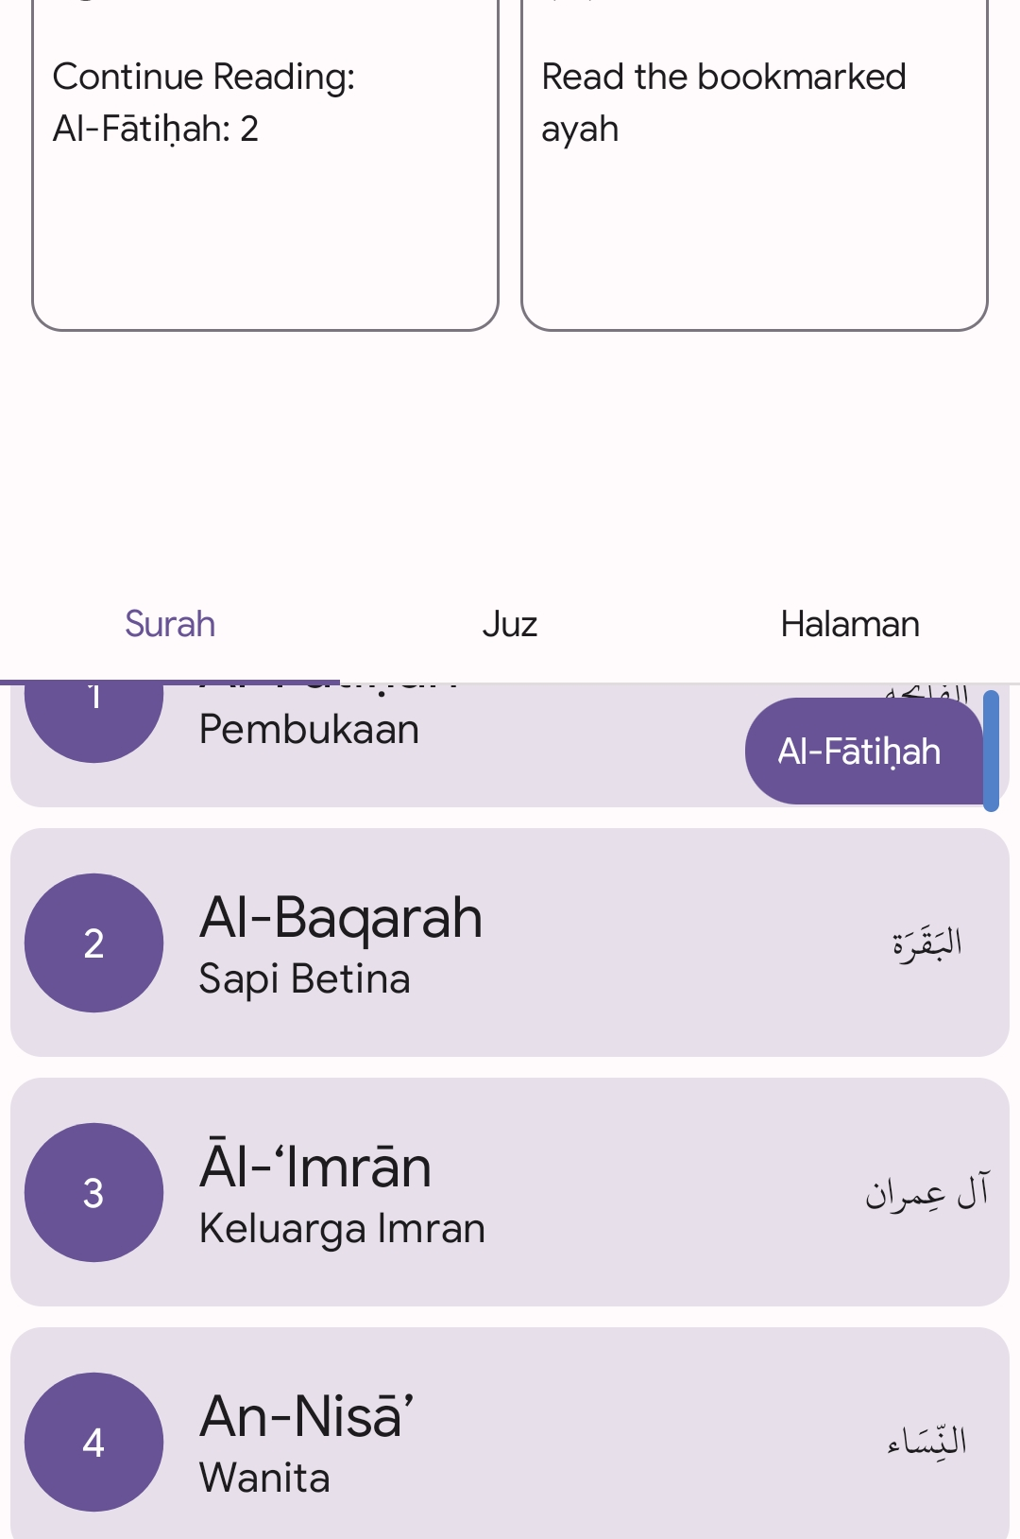
And for the fastscroll, we’re using a library named LazyColumnScrollBar made by nanihadesuka
Index by Surah
Index by Juz
Index by Page
…
…
LazyColumnScrollbar
LazyColumn
Components

Slide 9
Navigation Replacement

Slide 10
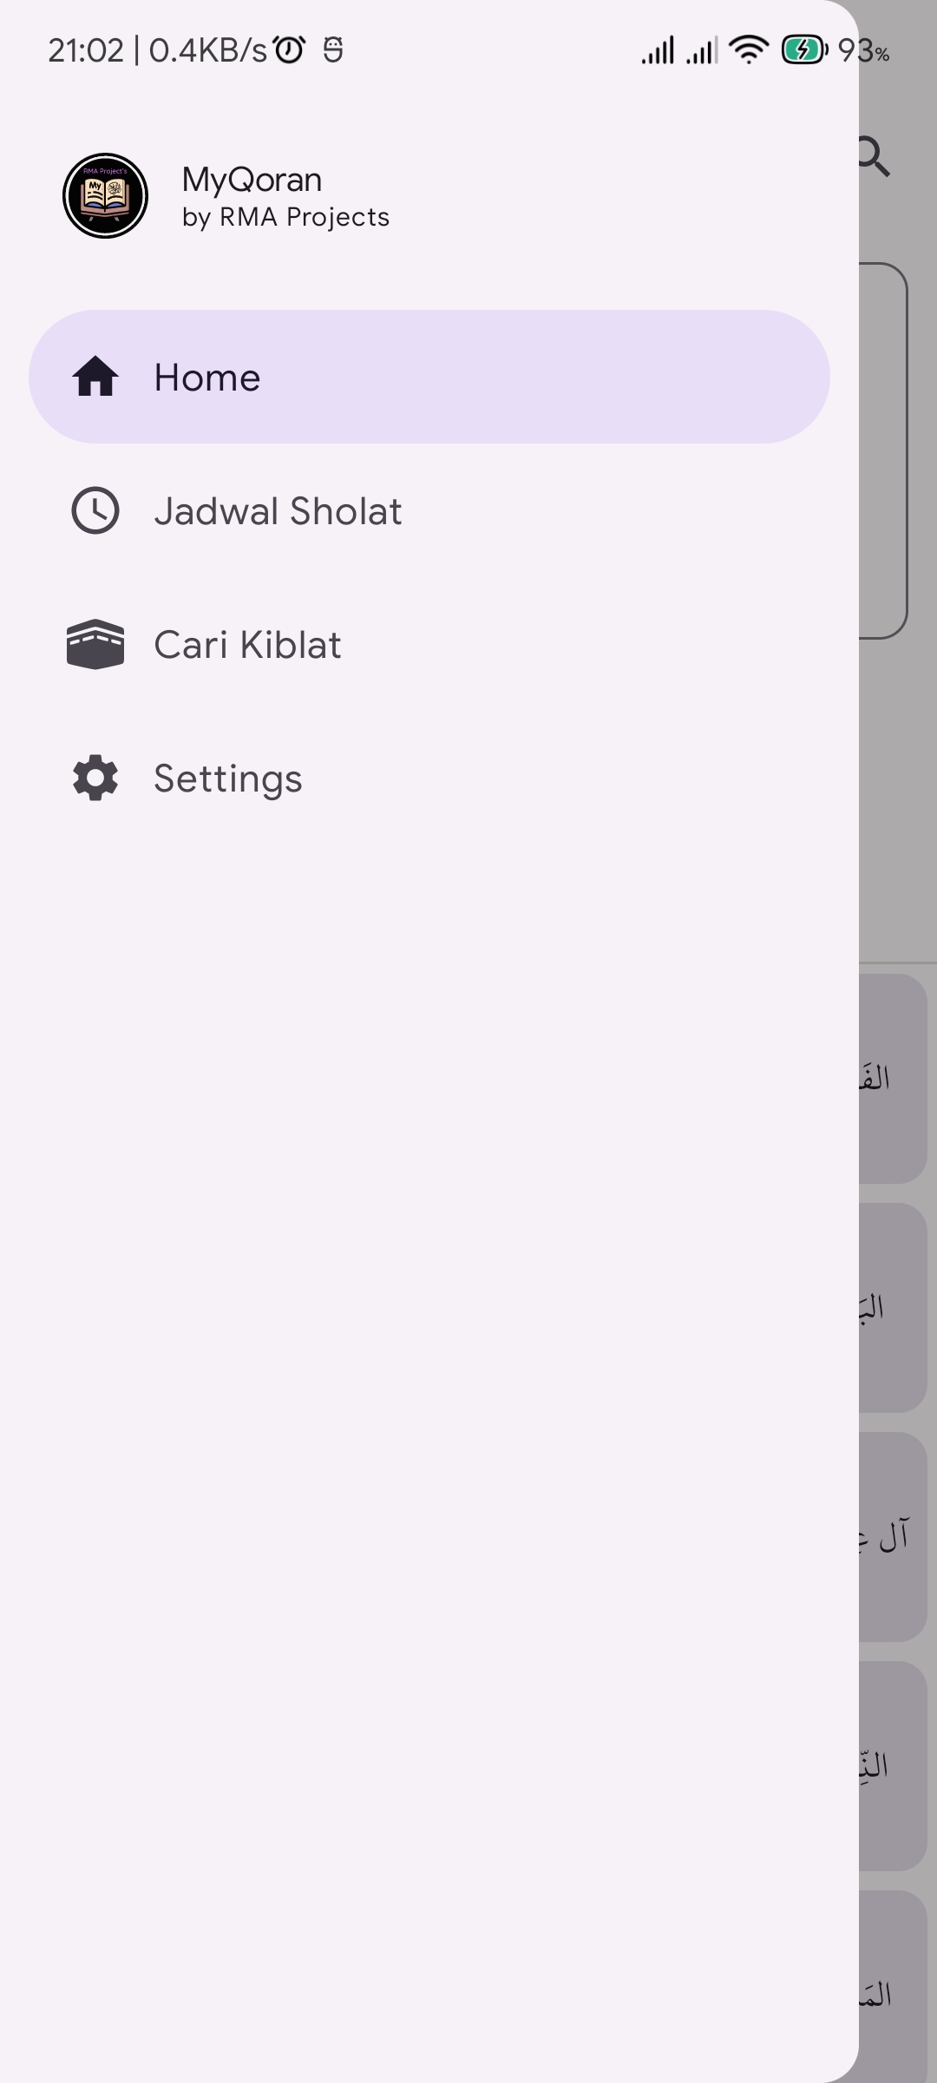
Navigation Replacement

Slide 11
Navigation Replacement
We changed the navigation style because we realise that it was so awful to have 2 types of navigation behaviour

Slide 12
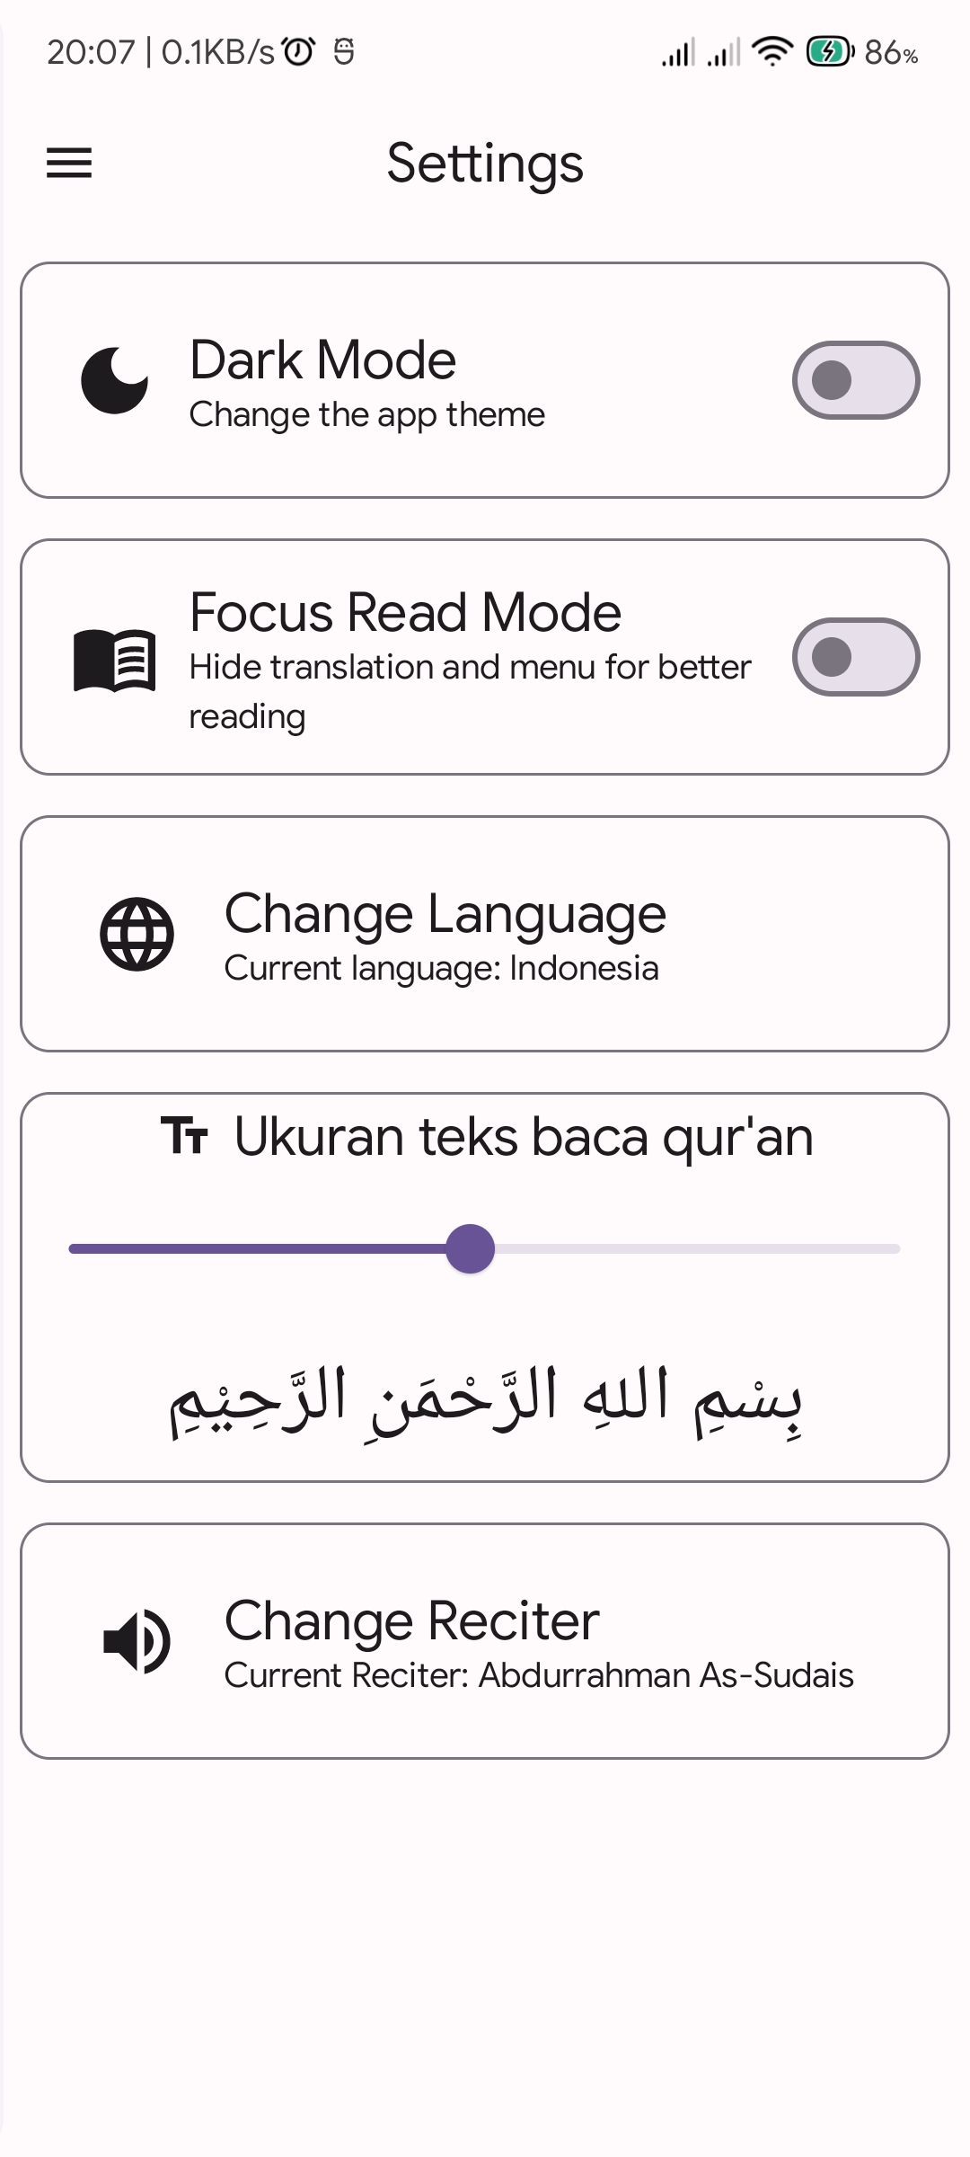
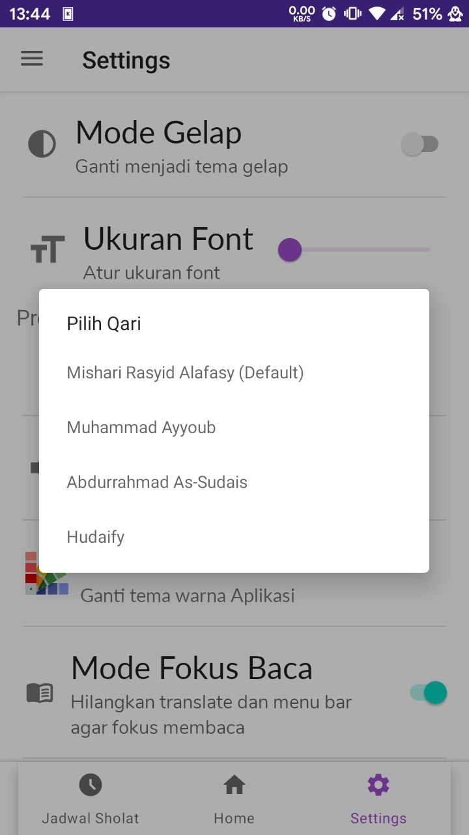
Settings Screen

Slide 13
What have changed:
Redesign
Removed unnecessary components
Added change language for Qoran Translation
Removes change theme option since many devices now supports dynamic colours

Slide 14
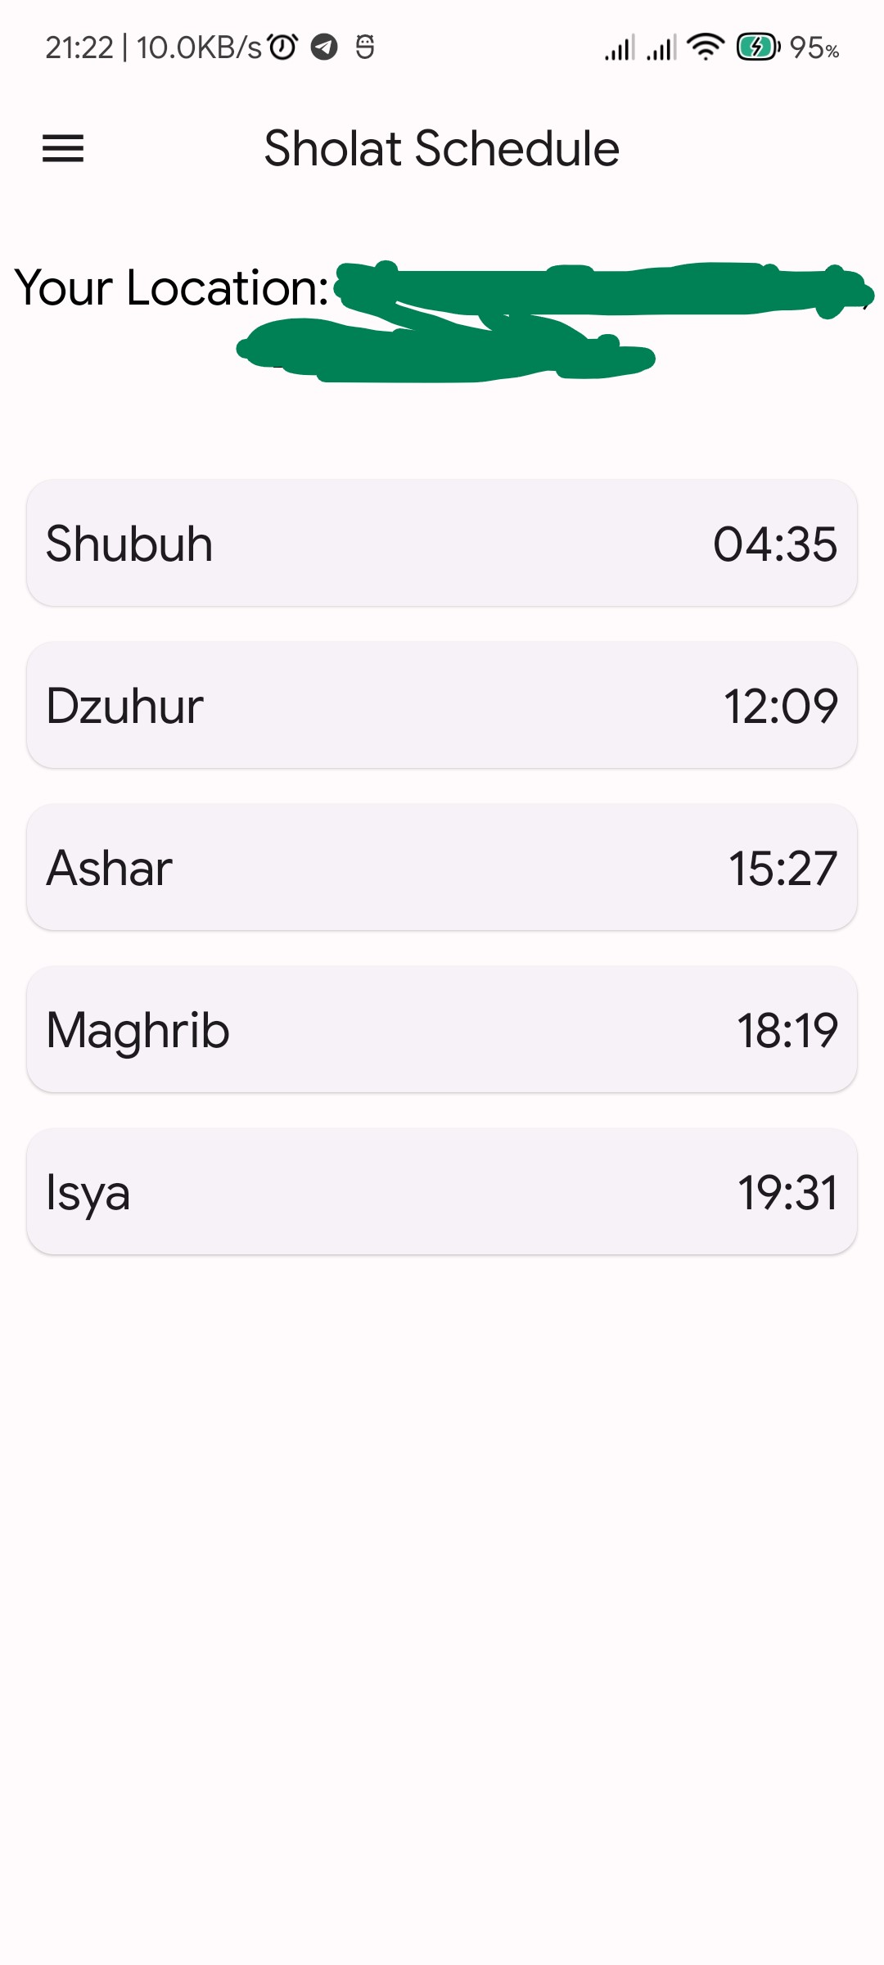
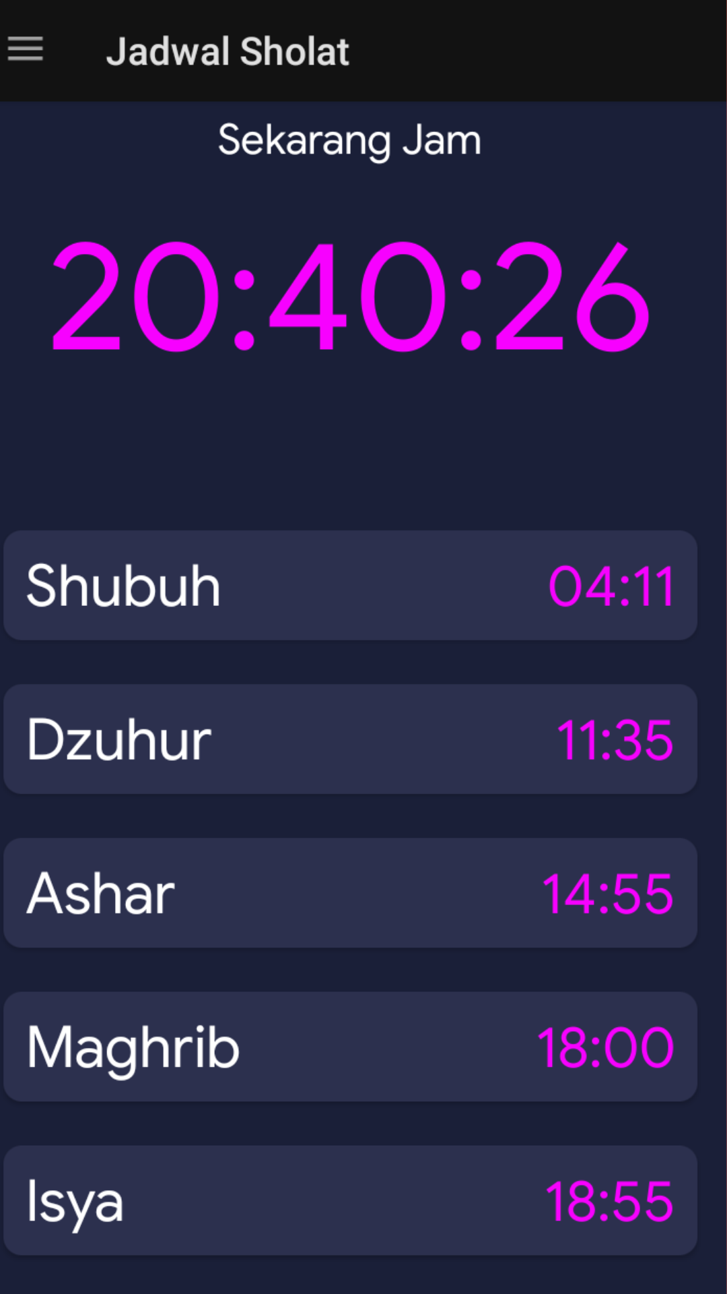
Adzan Schedule
Screen

Slide 15
What have changed:
Redesign
Removed current clock display since it unnecessary, moved your location display on the top instead
Loading animation on load

Slide 16
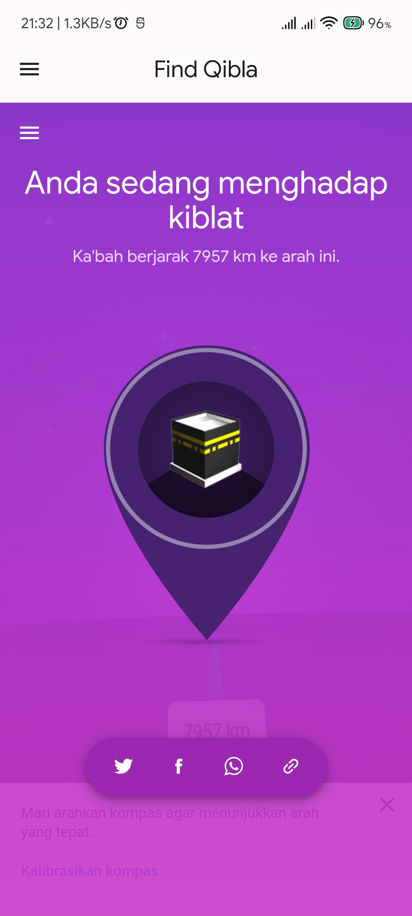
Kibla Finder Screen

Slide 17
What have changed:
Nothing has changed, just migrating AgentWeb library implementation into AndroidView covered with LinearLayout
AndroidView
LinearLayout
AgentWeb (LayoutParams)

Slide 18
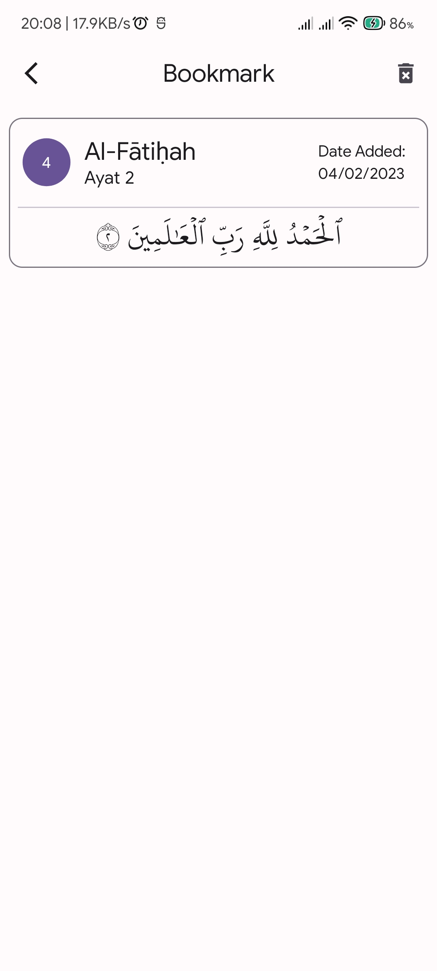
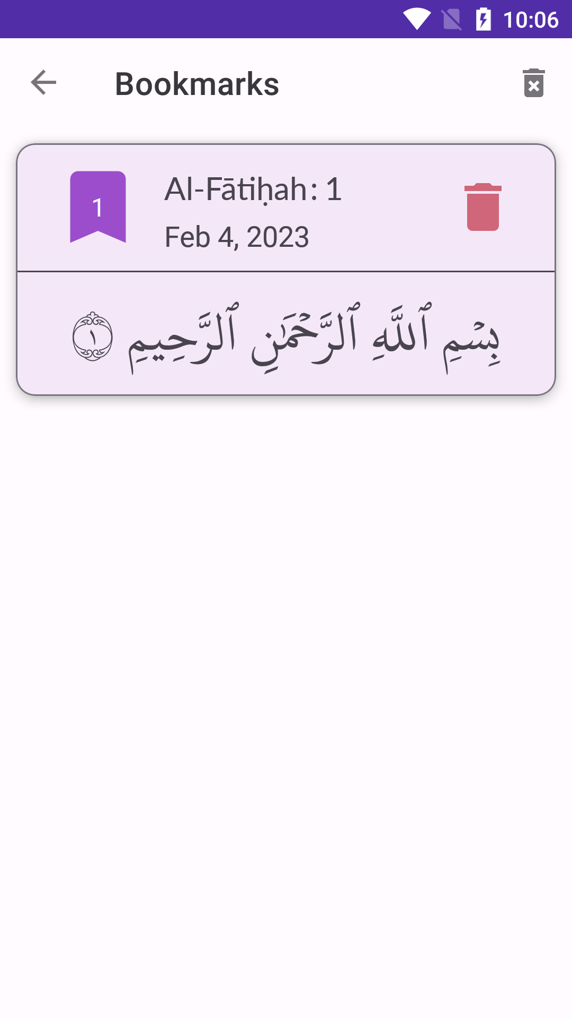
Bookmark Screen

Slide 19
What have changed:
Changing behaviour of deleting bookmark, instead of clicking trash button, we changed it into swipe to delete

Slide 20
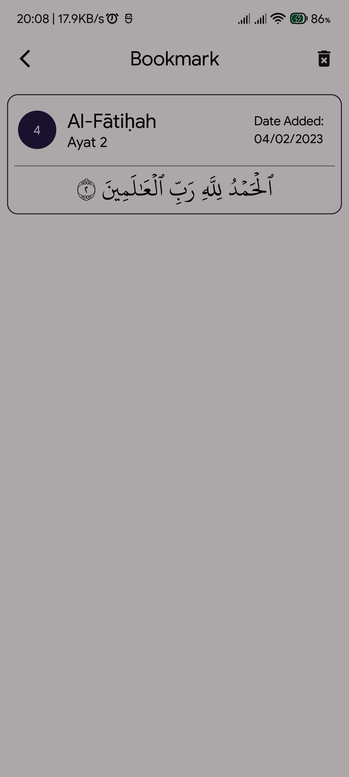
Because many users had a bad experience with one-click delete on previous non-compose app, so we changed the behaviour.
Users can now delete the Bookmark by easily swipe it into the left.

Slide 21
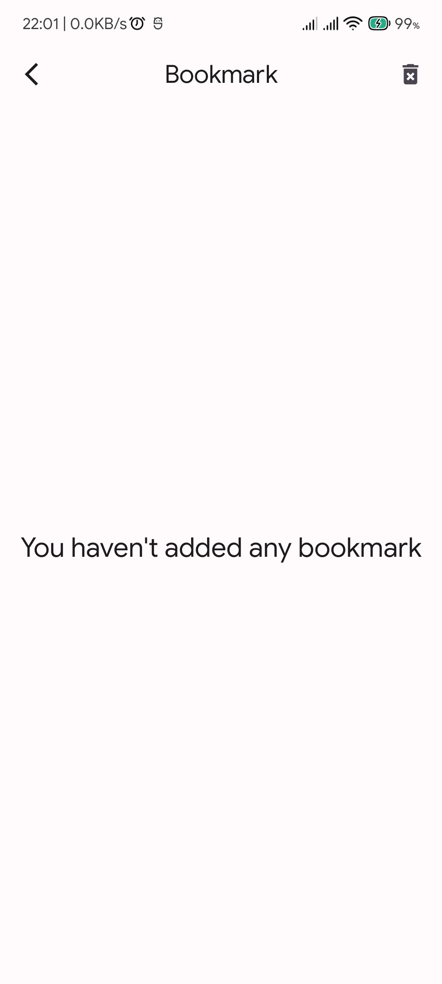
We can achieve this by wrapping SwipeToDismiss component into our items in LazyColumn
LazyColumn
SwipeToDismiss
BookmarkCard

Slide 22
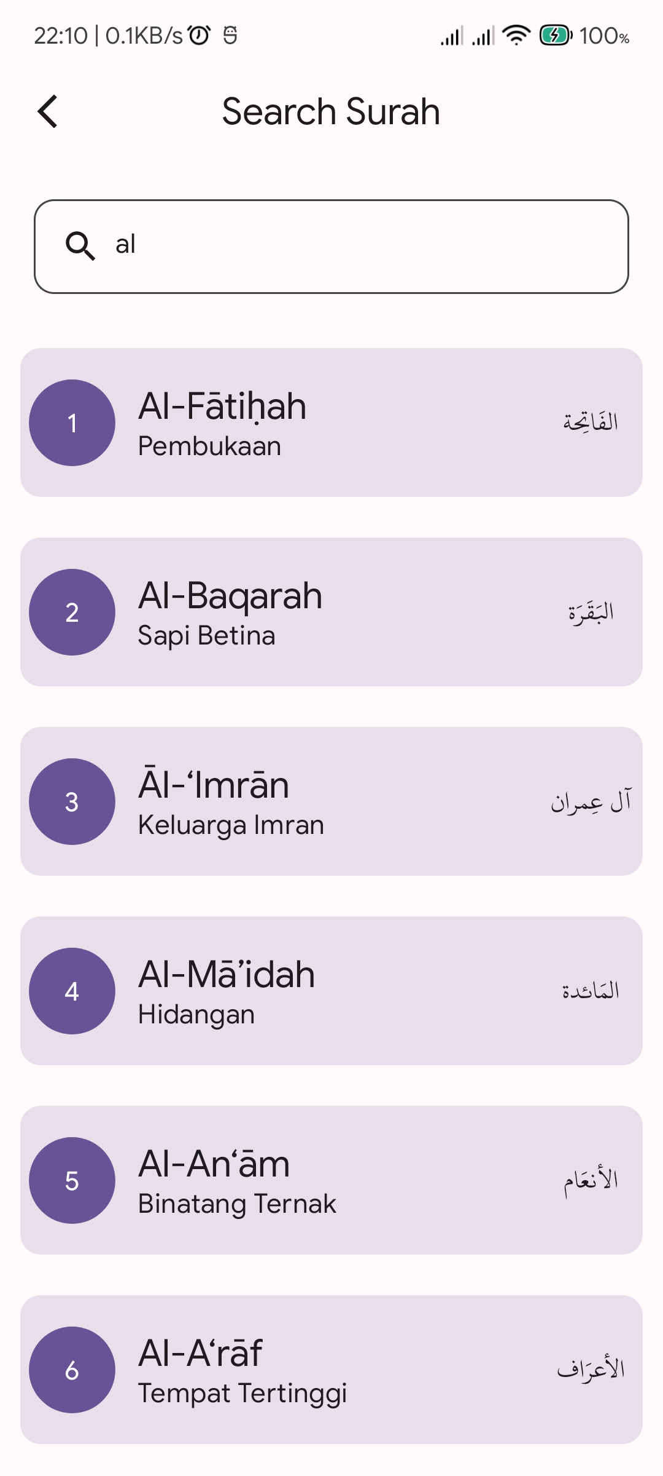
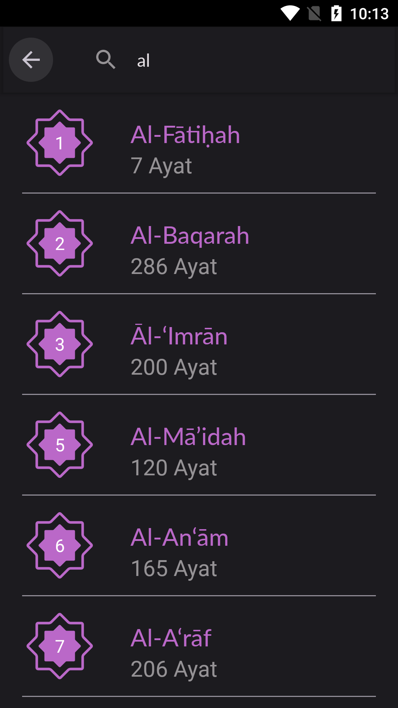
Search Surah Screen

Slide 23
What have changed:
Redesign
Now surahs are wrapped inside cards.
Moved the searchbox in the middle of screen for readability
Increased touch size of card for touchability
Search on type instead search on Enter

Slide 24
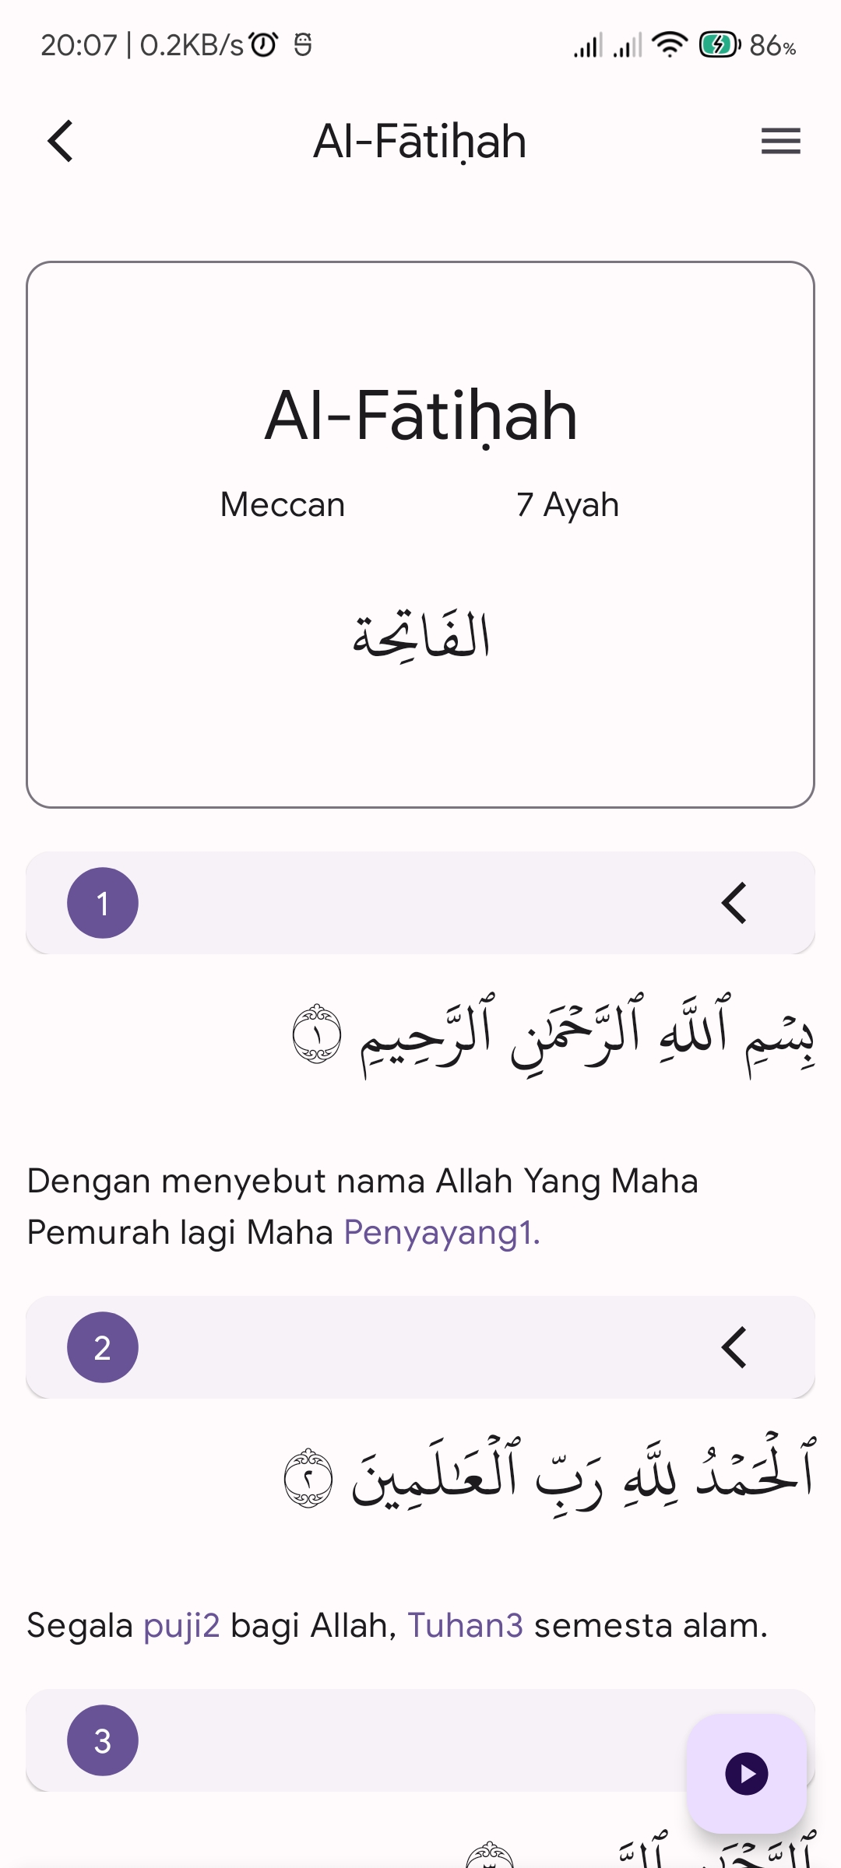
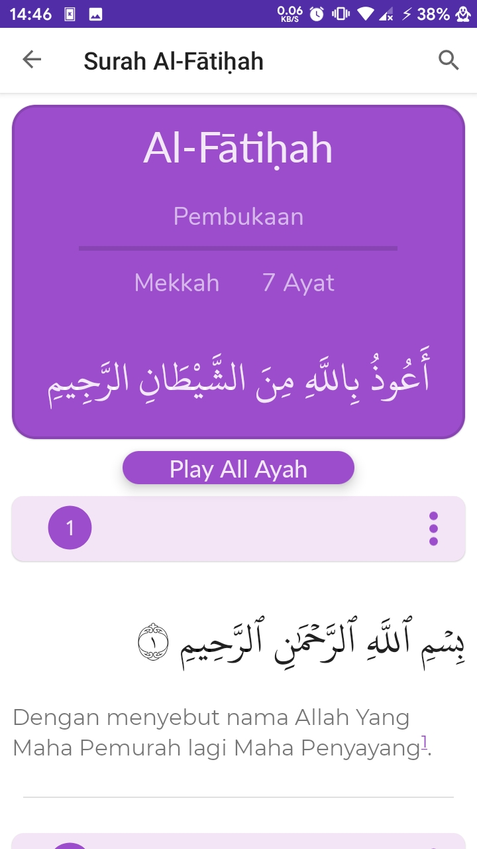
Read Qoran Screen

Slide 25
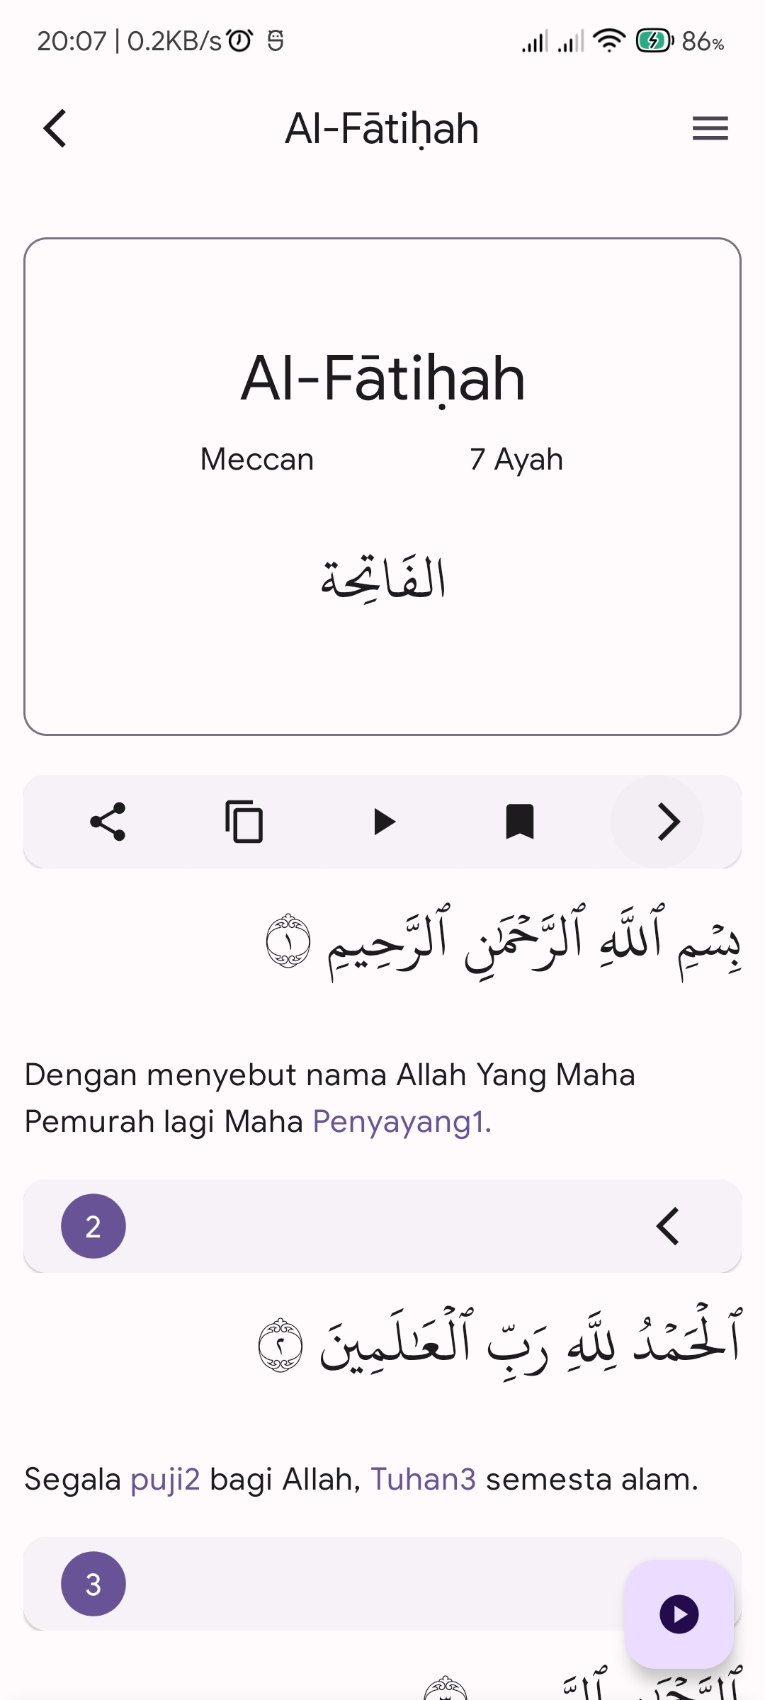
What have changed:
Redesign
Play all ayah moved to FAB down below
More cleaner look
You can now navigate between surah, ayah, and juz with drawer at right.
Tajweed colour now more pastels
Dynamic read by indexType

Slide 26
So, this app can play surah and ayah, how can we made it?

Slide 27
Share Ayah
Copy Ayah
Play Ayah
Bookmark Ayah
These control panel buttons has its own function, that sends an information to viewmodel to process it.

Slide 28
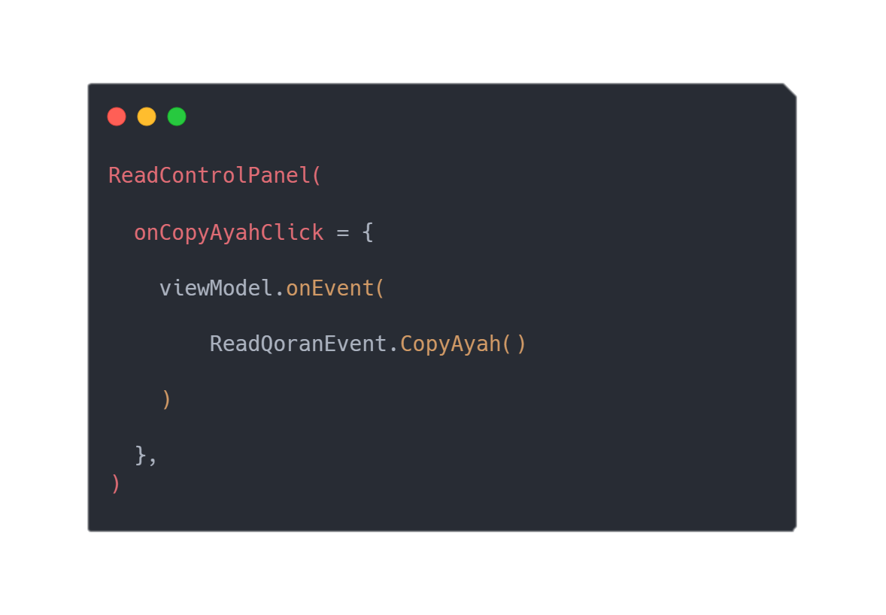
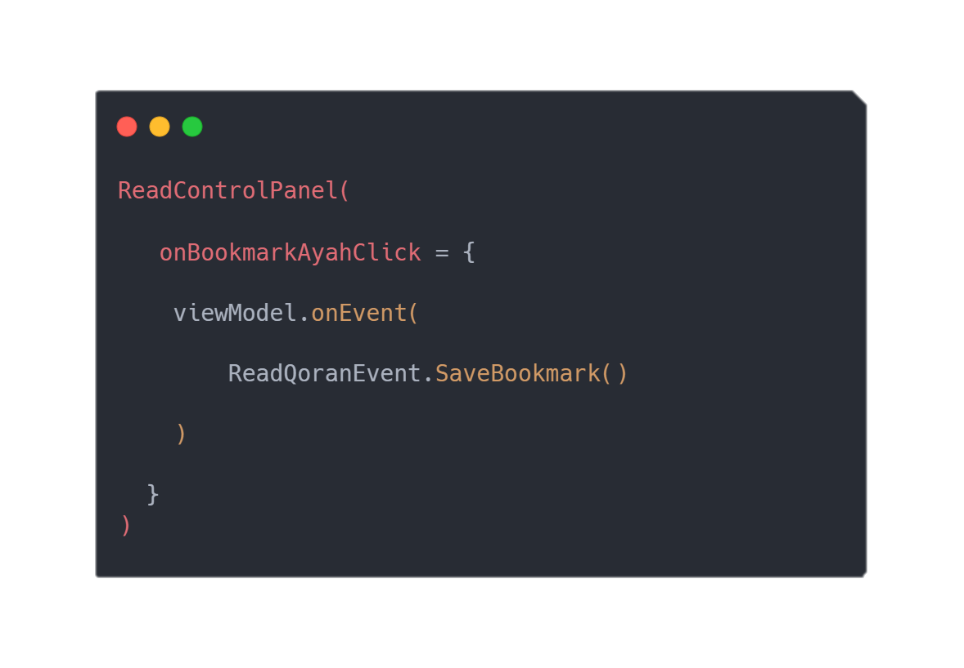

These control panel button has its own function, that sends an information to viewmodel to process it.

Slide 29
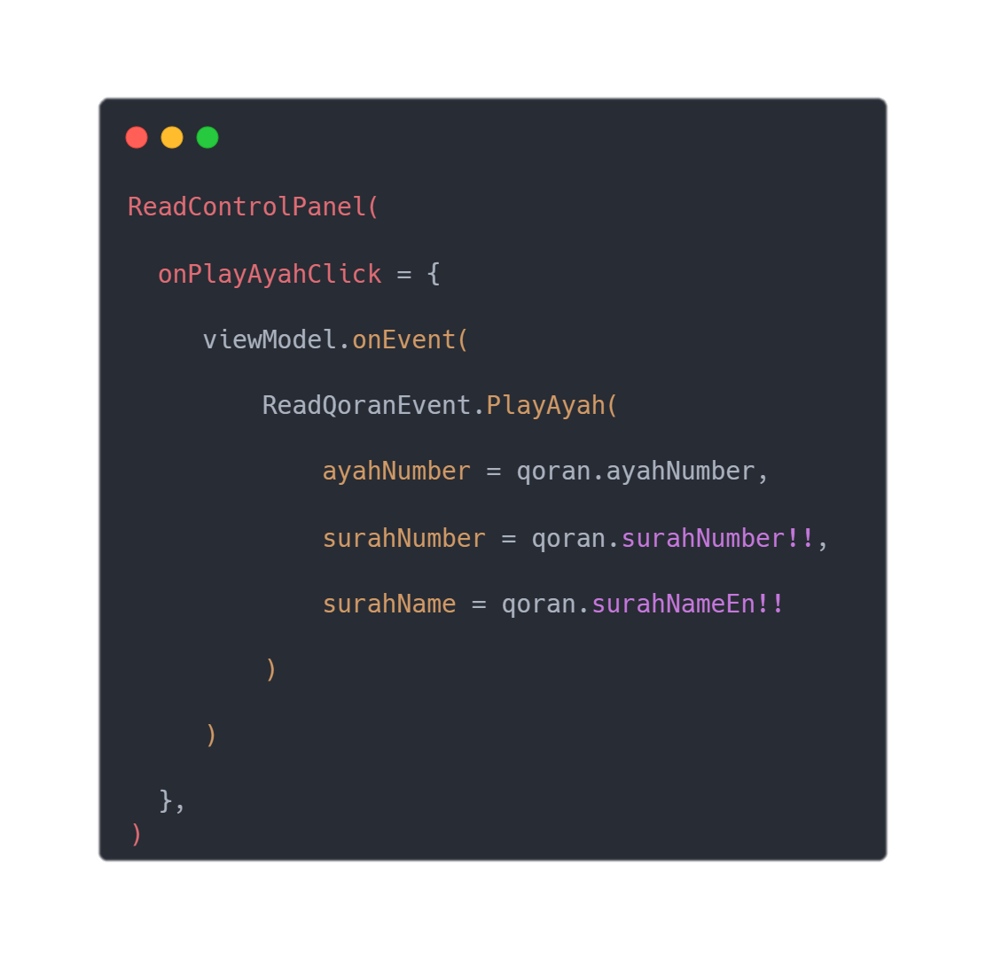
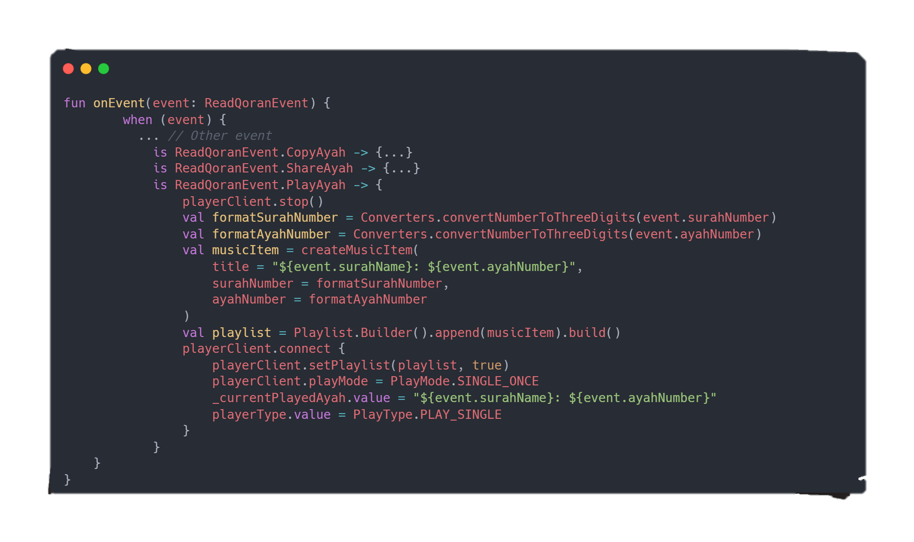
While for play ayah:
ReadQoranScreen.kt
ReadQoranViewModel.kt

Slide 30
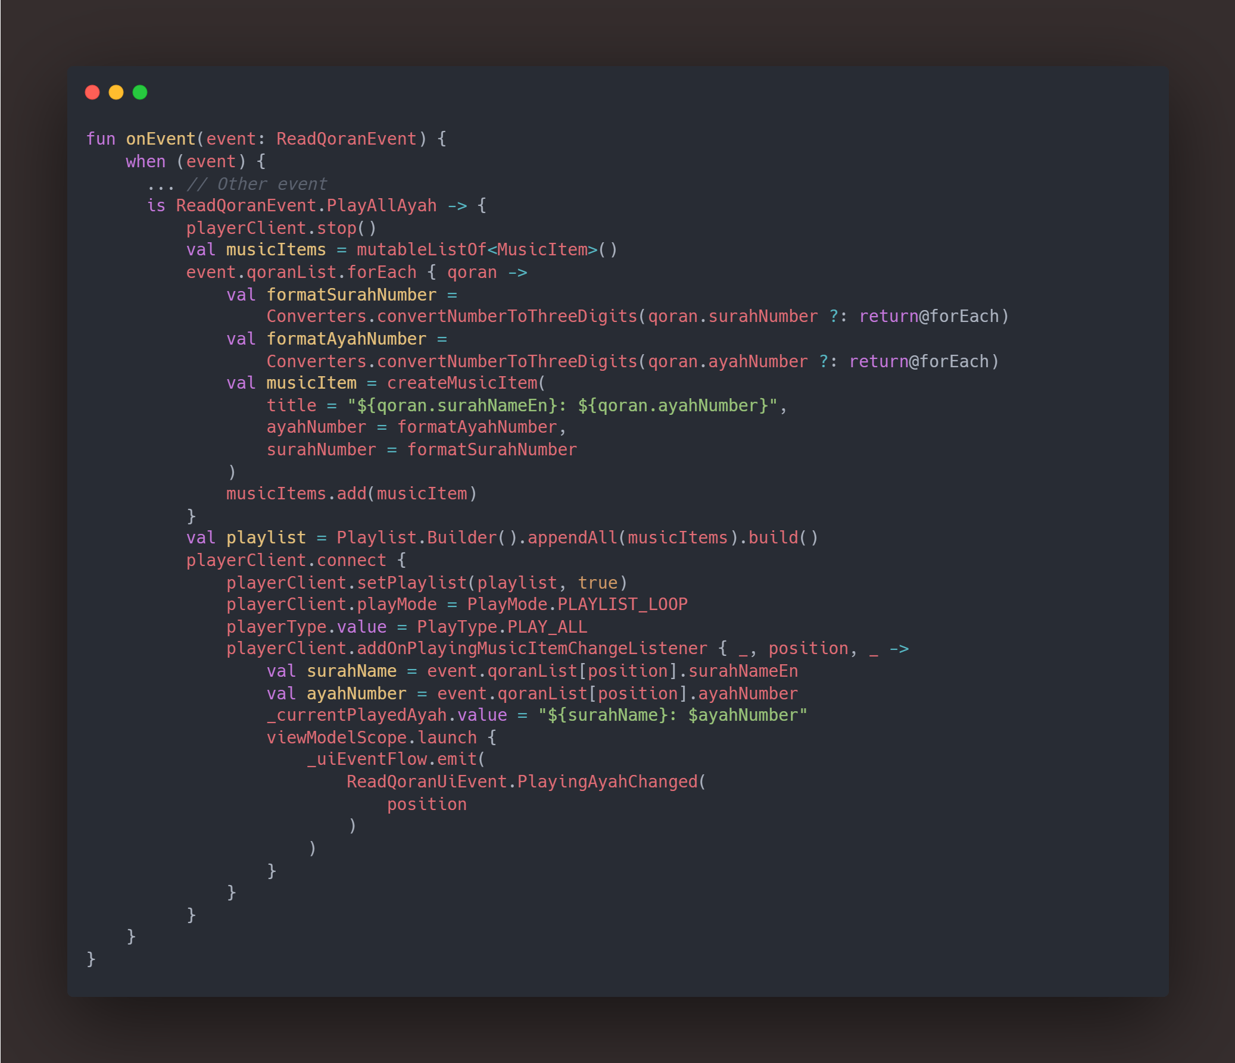
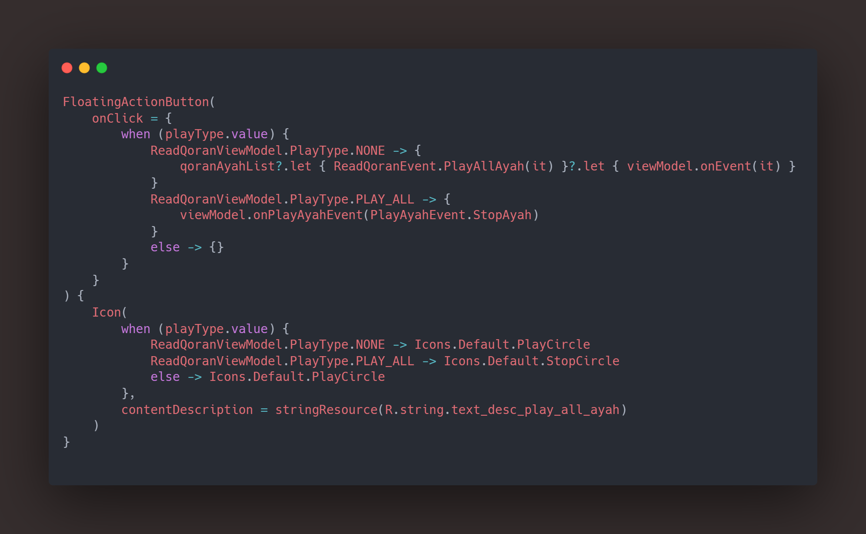
Same case applies to Play All Ayah, but it’s clicked from FAB:
ReadQoranScreen.kt
ReadQoranViewModel.kt

Slide 31
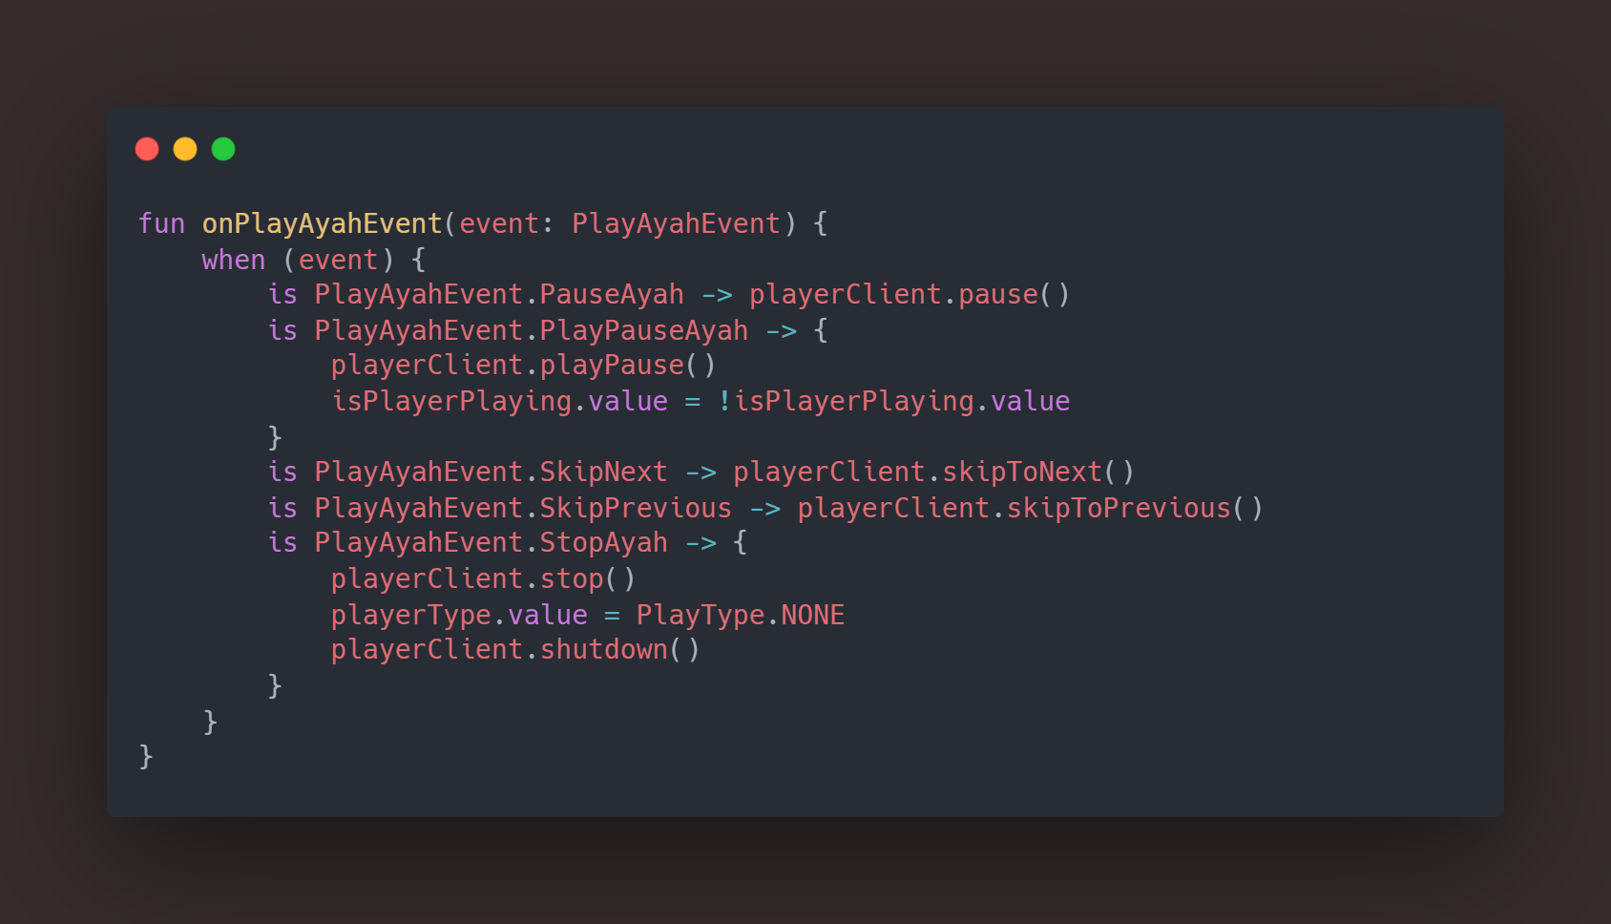
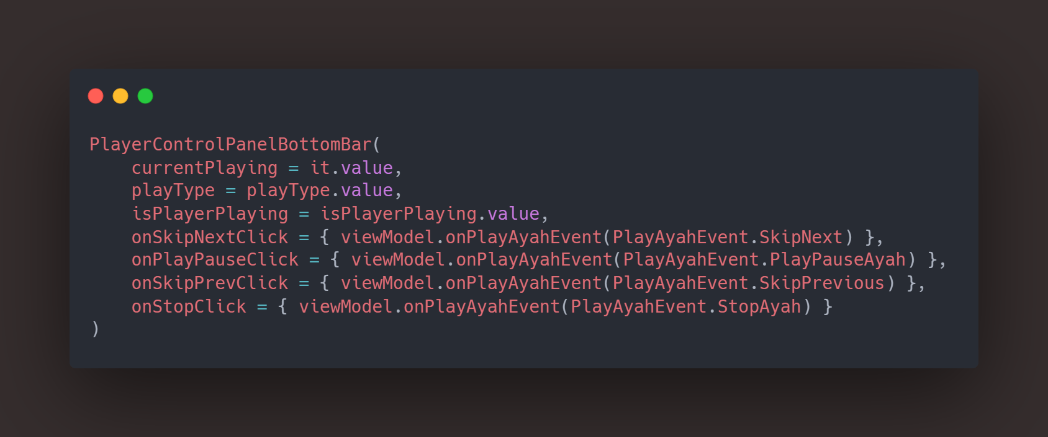
And if every ayah plays there is a control panel (in this case it’s a BottomBar) that controls the playback of the currently played ayah
ReadQoranScreen.kt
ReadQoranViewModel.kt

Slide 32
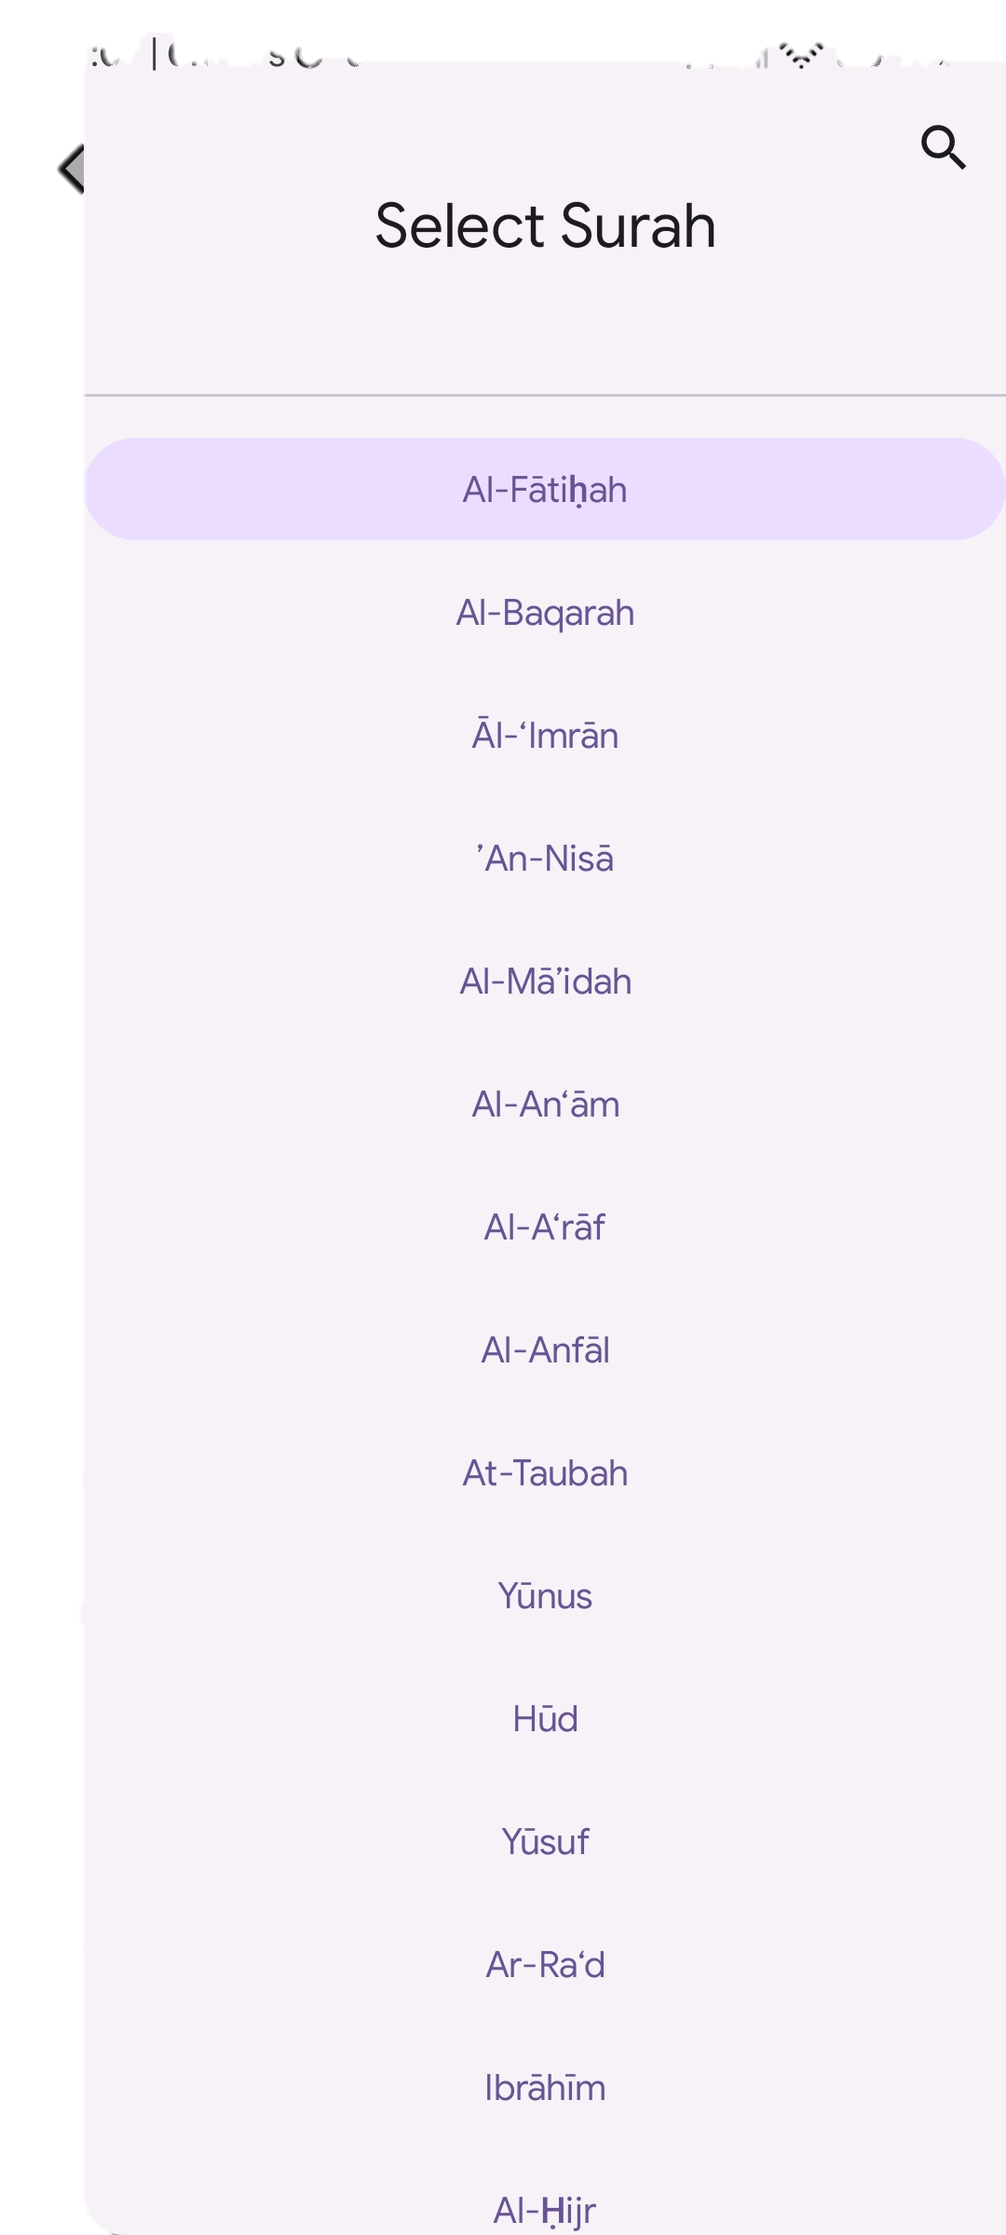
How about the navigation drawer?

Slide 33
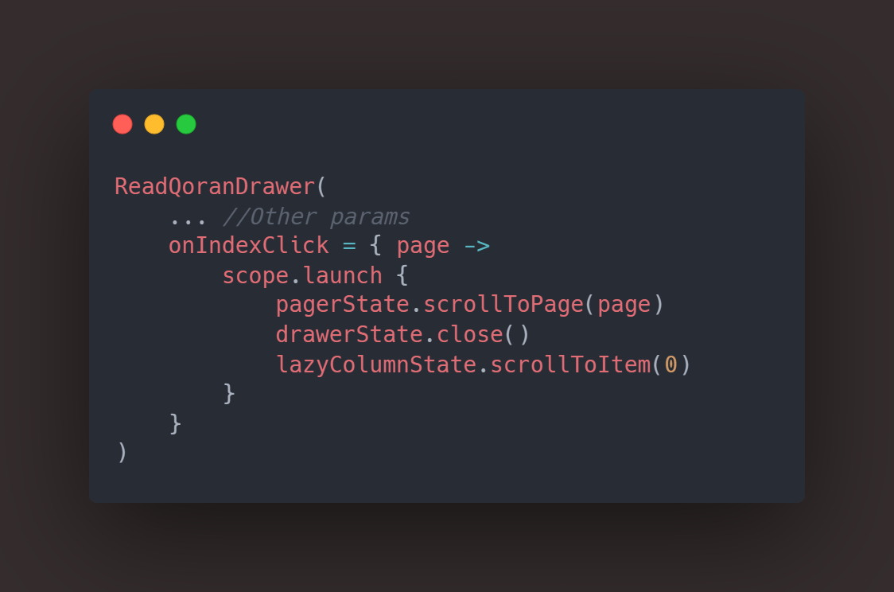
Since we used pager in the Home Screen, we reused the pager to make this possible. When the navigation buttons clicked, it sends surah/juz/page number as a position into the pager, and pager will navigate us to our desired position

Slide 34
So, for the final structure of Read Ayah will be like this:
Pager
Drawer
LazyColumnScrollBar
Lazy Column
Scaffold
BottomBar
(Play Ayah Control panel)
ModalBottomSheet
(Footnotes)

Slide 35
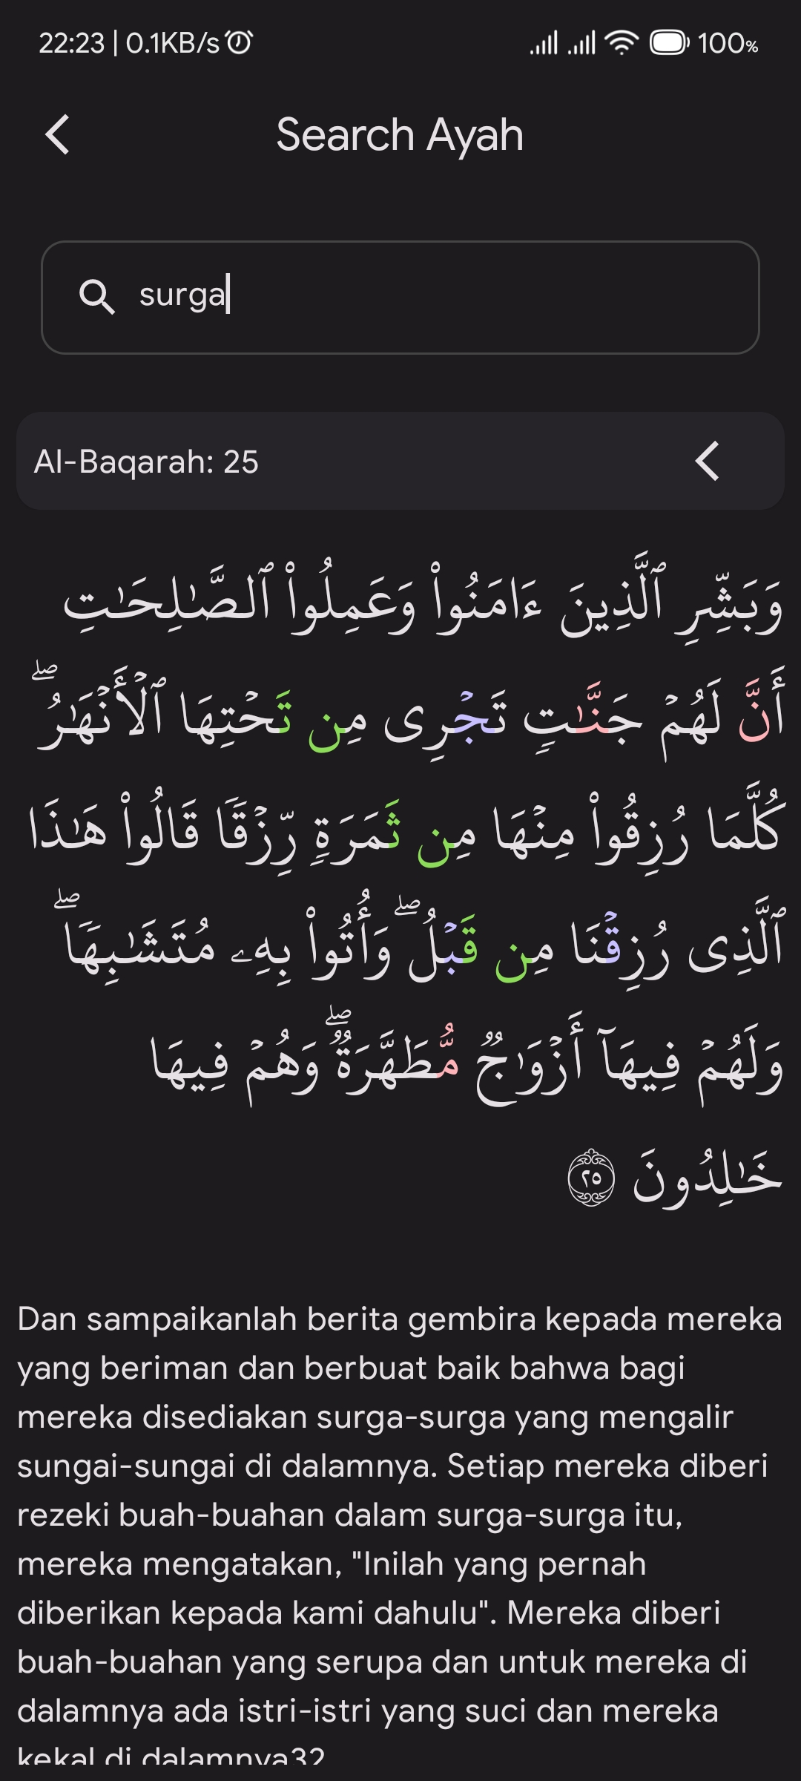
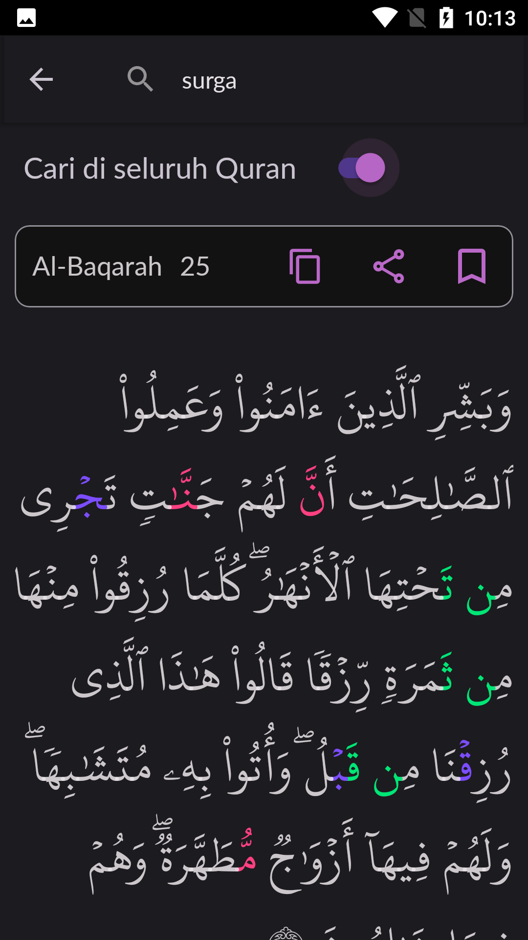
Search Ayah Screen

Slide 36
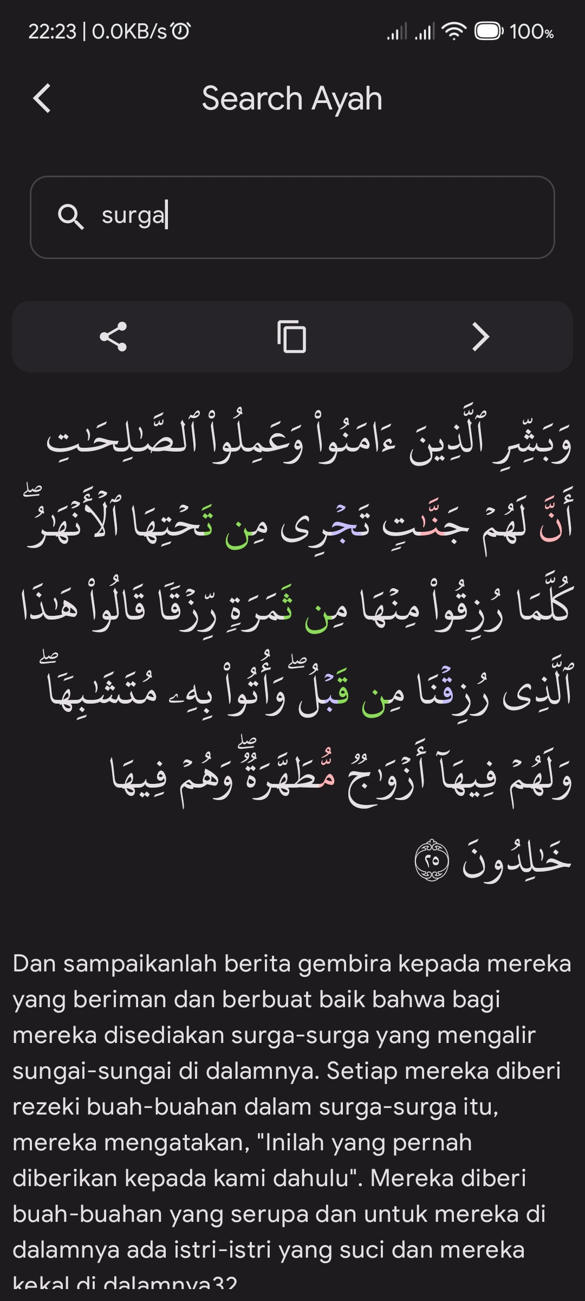
What have changed:
Overall same as search surah.
But, because this is Ayah Search, we provide button for copying and sharing the ayah text, previously we provided the bookmarks button too, but we removed it here, because we can’t determine which type of index type to read.

Slide 37
Migration Percentage
Home Screen – 100% + Improvement
Read Screen – 100% + Improvement
Search Surah – 100% + Improvement
Bookmarks – 100% + Improvement
Find Qibla – 100%
Settings Screen – 100%
Search Ayah – 100%
Sholat Schedule – 90%

Slide 38
Migration Percentage
From 8 Screens,
4 Screens had 100% Migration + Improvement
Thanks to Jetpack Compose that made the improvement easily.
Others migrated successfully
And the last one migrated successfully, but minus in error handling

Slide 39
Thanks for reading!
MyQoran by RMA Projects

